Slide 1
CSE231 – Digital Logic Design
Counters

Slide 2
Counters
Asynchronous Counters
(aka. Ripple Counters)

Slide 3
4-bit (up) Counter
Let each bit in the counter be represented by the output of a flip-flop.
Count | A₃ | A₂ | A₁ | A₀
0 | 0 | 0 | 0 | 0
1 | 0 | 0 | 0 | 1
2 | 0 | 0 | 1 | 0
3 | 0 | 0 | 1 | 1
4 | 0 | 1 | 0 | 0
5 | 0 | 1 | 0 | 1
6 | 0 | 1 | 1 | 0
7 | 0 | 1 | 1 | 1
Count | A₃ | A₂ | A₁ | A₀
8 | 1 | 0 | 0 | 0
9 | 1 | 0 | 0 | 1
10 | 1 | 0 | 1 | 0
11 | 1 | 0 | 1 | 1
12 | 1 | 1 | 0 | 0
13 | 1 | 1 | 0 | 1
14 | 1 | 1 | 1 | 0
15 | 1 | 1 | 1 | 1
0 | 0 | 0 | 0 | 0

Slide 4
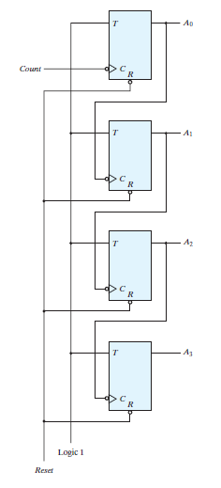
4-bit (up) Counter: T Flip-Flops
Counter does not
use a common clock.
Asynchronous
Counter

Slide 5
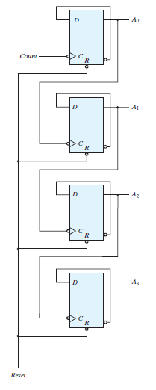
4-bit (up) Counter: D Flip-Flops
Counter does not
use a common clock.
Asynchronous
Counter

Slide 6
Counters
Synchronous Counters

Slide 7
4-bit (up) Counter
As before, let each bit in the counter be represented by the output of a flip-flop.
Count | Q₃ | Q₂ | Q₁ | Q₀
0 | 0 | 0 | 0 | 0
1 | 0 | 0 | 0 | 1
2 | 0 | 0 | 1 | 0
3 | 0 | 0 | 1 | 1
4 | 0 | 1 | 0 | 0
5 | 0 | 1 | 0 | 1
6 | 0 | 1 | 1 | 0
7 | 0 | 1 | 1 | 1
Count | Q₃ | Q₂ | Q₁ | Q₀
8 | 1 | 0 | 0 | 0
9 | 1 | 0 | 0 | 1
10 | 1 | 0 | 1 | 0
11 | 1 | 0 | 1 | 1
12 | 1 | 1 | 0 | 0
13 | 1 | 1 | 0 | 1
14 | 1 | 1 | 1 | 0
15 | 1 | 1 | 1 | 1
0 | 0 | 0 | 0 | 0

Slide 8
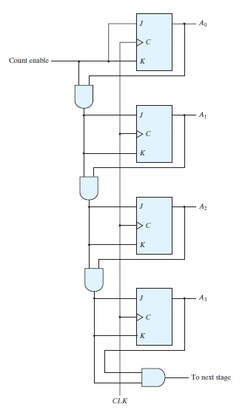
4-bit (up) Counter: JK Flip-Flops
Counter uses
a common clock.
Synchronous
Counter

Slide 9
Synchronous Counters
Binary Counter with Parallel Load

Slide 10
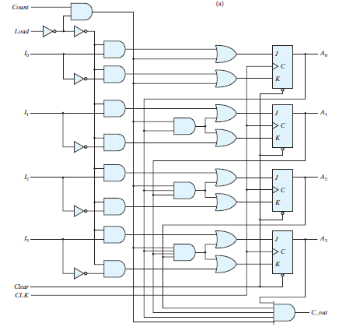
4-bit Counter with Parallel Load

Slide 11
Synchronous Counters
Modulo-6 Counter

Slide 12
Counters
BCD (Decimal) Counter
(aka. Modulo-10 Counter)

Slide 13
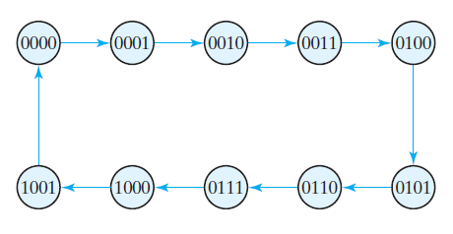
BCD Counter: State Diagram

Slide 14
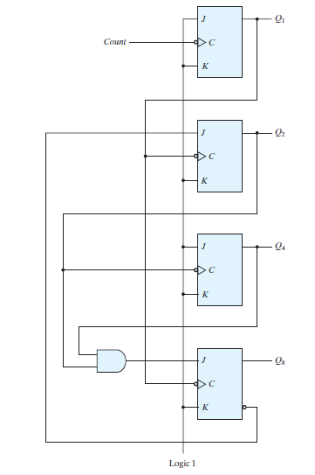
BCD Counter: JK Flip-Flops
Asynchronous
Counter

Slide 15
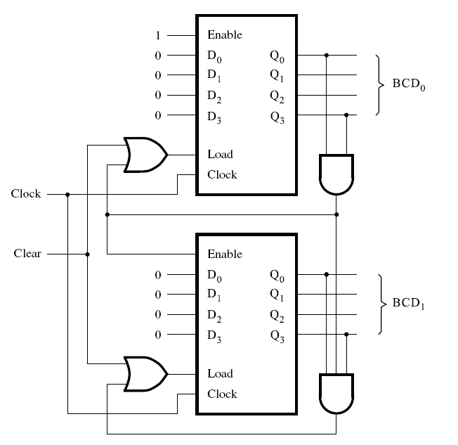
BCD Counter: D Flip-Flops
Synchronous
Counter

Slide 16
Synchronous Counters
Up / Down Counter

Slide 17
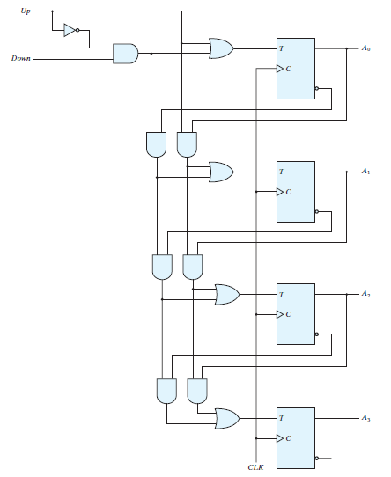
4-bit Up / Down Counter

